Slide 1

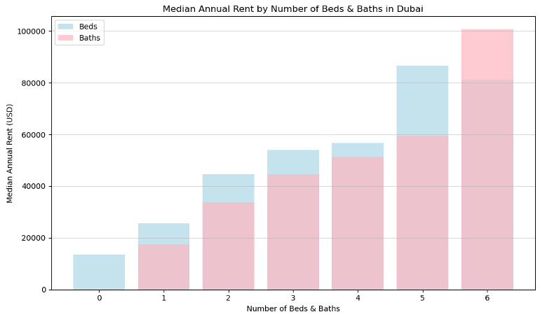
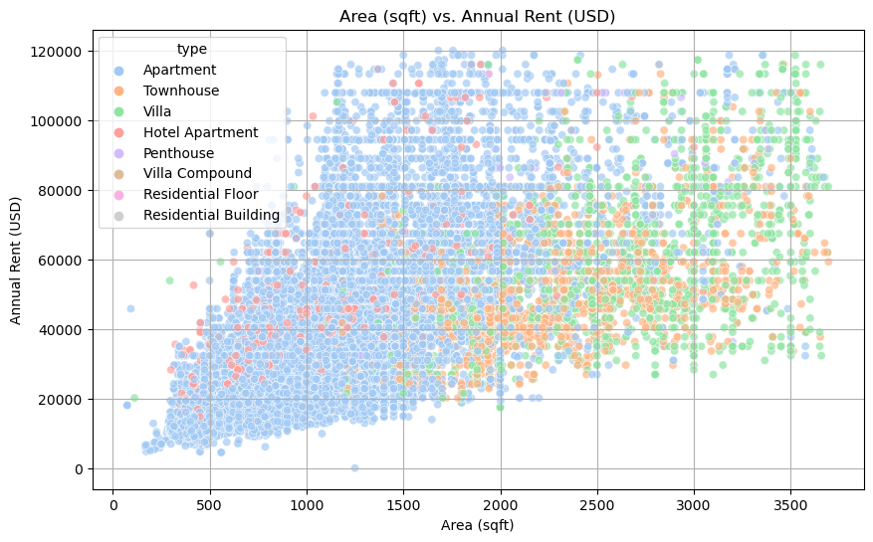

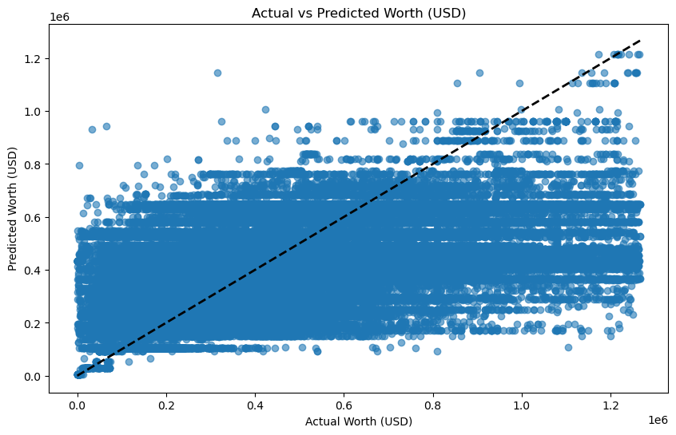
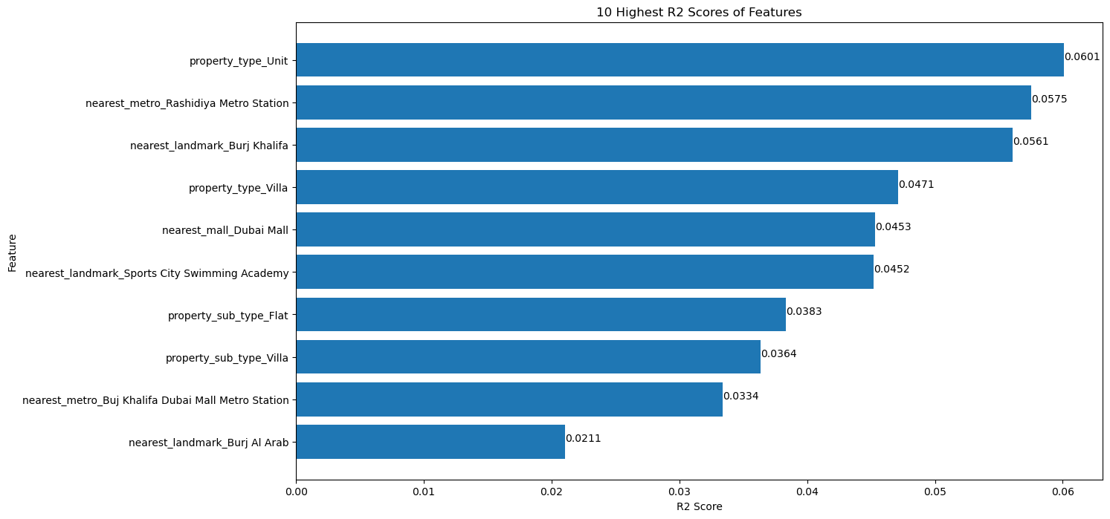
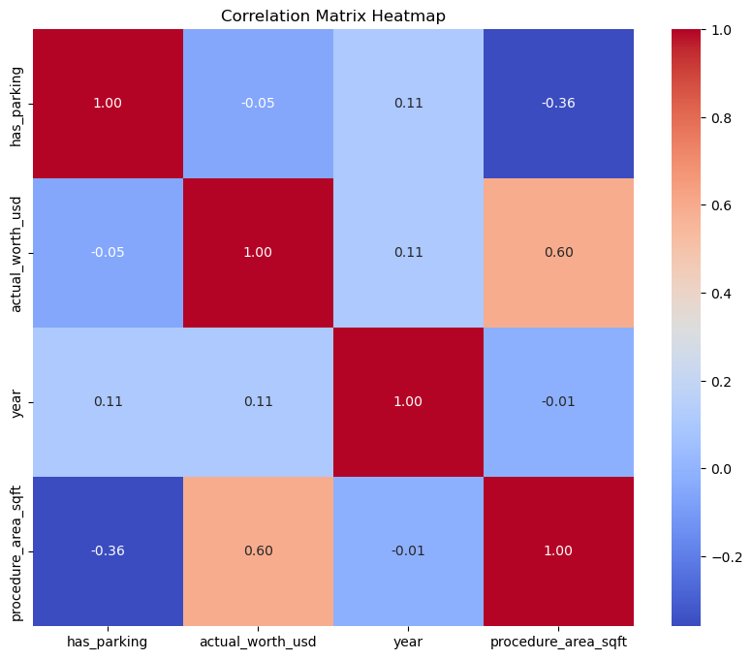
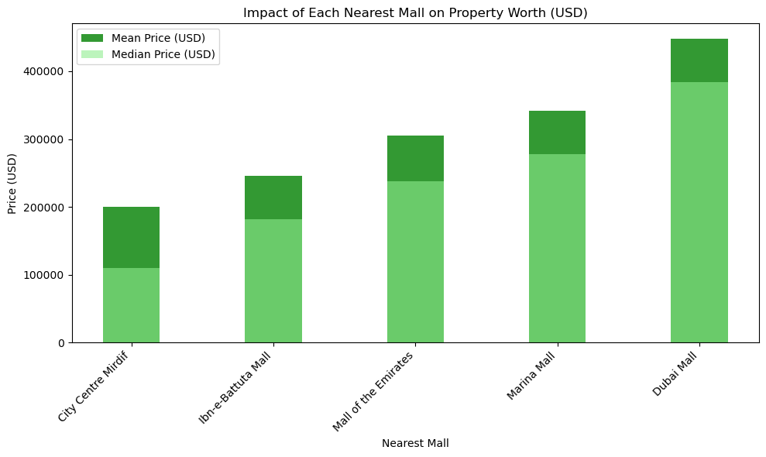
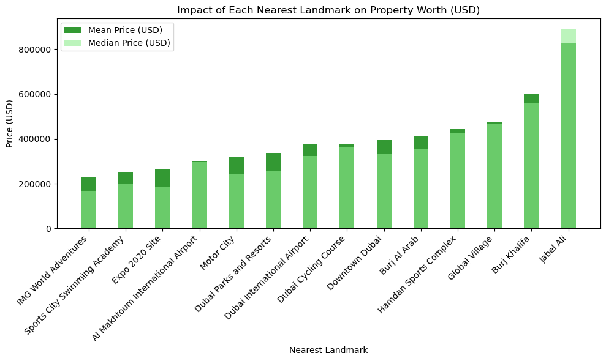
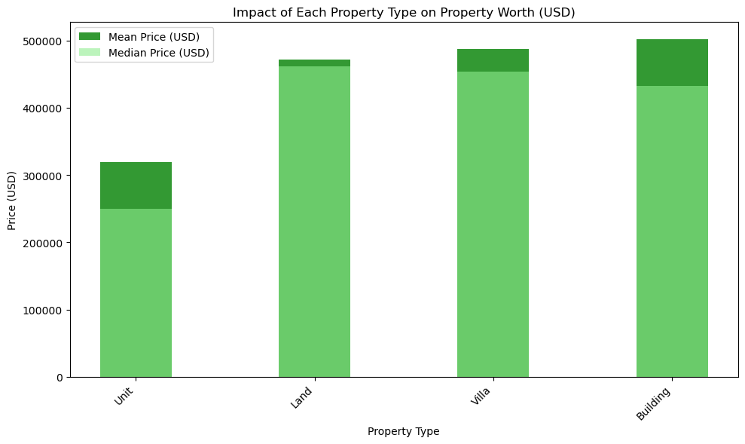
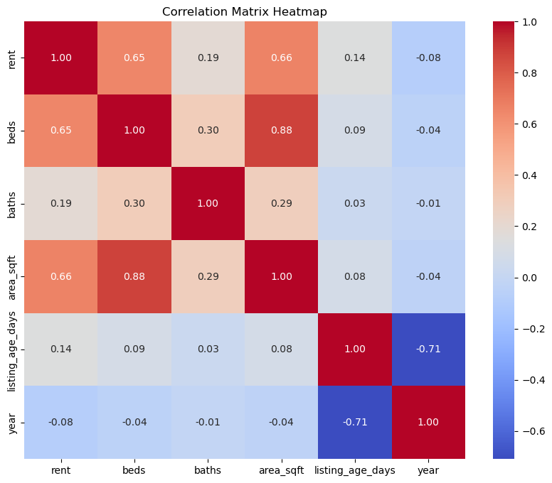
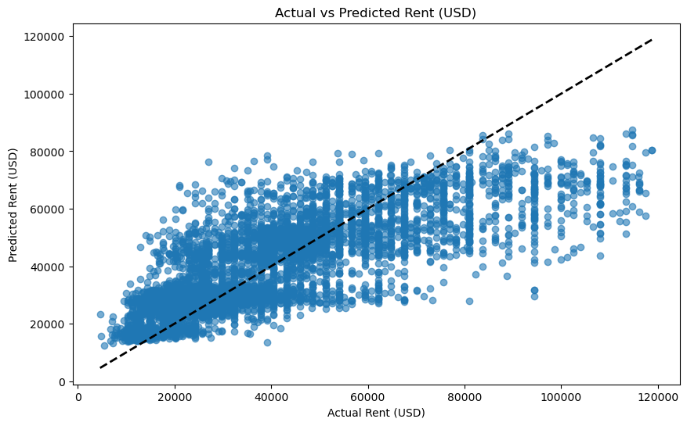
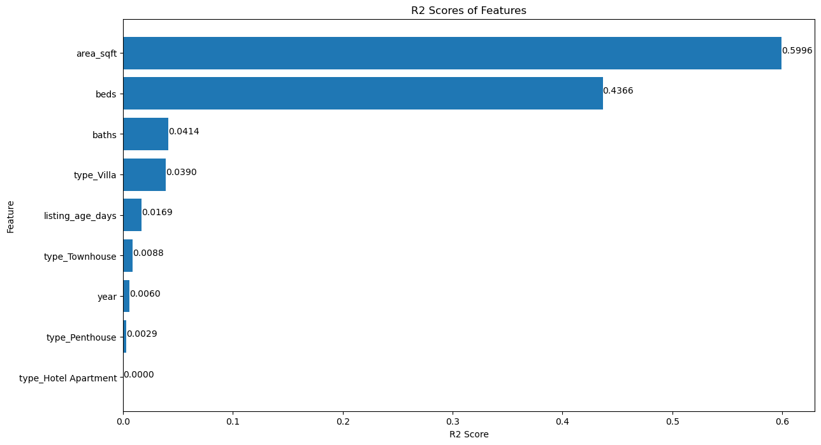

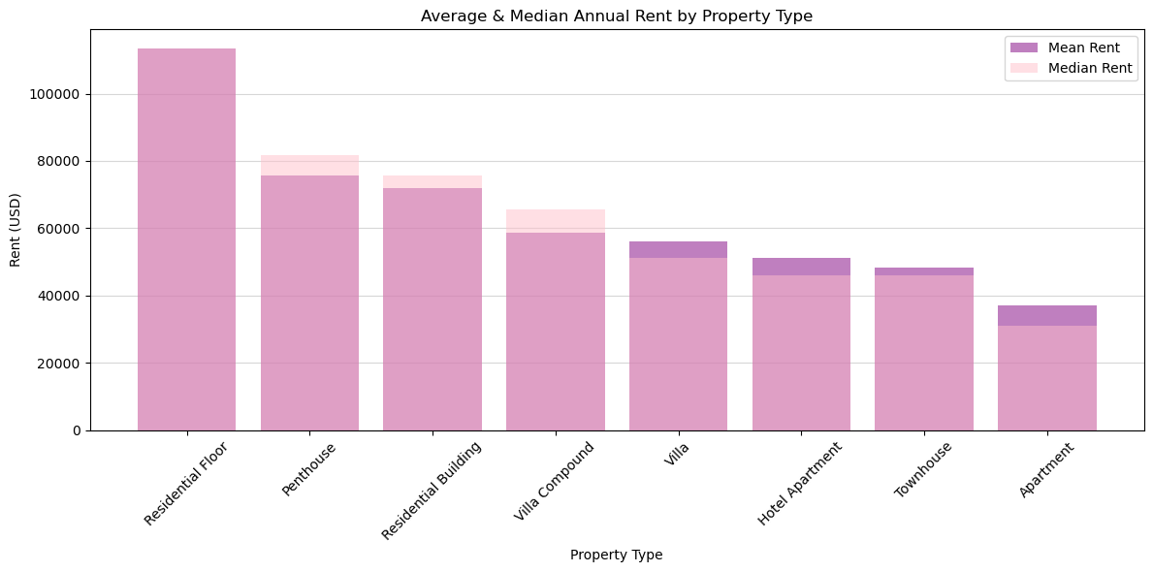
Dubai Real Estate Price Prediction
Kiana J. & Thomas M.
Department of Computational and Data Sciences, George Mason University, Fairfax, VA
Abstract
2. “Dubai Real Estate Transactions Dataset"
Source: Kaggle (Dubai Pulse)
Figures 13 & 14: (13, left) Scatter plot of actual vs. predicted property worth (USD) for transactions data. Not as many points fall on the line of best fit (14, right) Horizontal Bar chart showing 'Villa,' 'Unit,' proximity to 'Rashidiya' metro, and 'Burj Khalifa' as top R2 values (best predictors).
This project focused on identifying key predictors of real estate property values in Dubai’s dynamic market, offering crucial insights for investors, families, construction companies, and real estate agents. By examining rental and transactional data, the project addressed data quality issues and standardized units. The analysis determined that property area, number of beds, and property type are the most influential factors in predicting rental values. Results showed moderate performance of the model on rental data but limited effectiveness on transactional data, highlighting that property-specific features are more reliable indicators of value than location-related factors.
Description: This dataset includes over 1,000,000 entries of real estate transactions in Dubai. Each case provides location-specific features of each property transaction.
Figure 2: Dubai Pulse Logo
Figures 5 & 6: (5, left) Stacked Bar chart median annual rent (USD) by bed and bath count. As the bed and bath count increase, the annual rent increases. (6, right) Scatterplot illustrating positive linear relationship between both the property area and price, color-coded by property type.
Preprocessing
Renamed variables for easier use and accessibility (all lower-case & descriptive)
Handled outliers using IQR method
Performed currency and measurement unit conversions (U.S. customary units)
Discussion
Research Questions
These results provide valuable insights into effective predictors of real estate prices in Dubai. Area and property type emerged as the most influential factors, while many location-specific variables, such as proximity to the nearest metro station, landmark, and mall, were surprisingly less effective. These findings challenge the common belief that location and accessibility are the most crucial factors in determining property value. Instead, physical attributes like area, the number of beds, and property type play a more critical role. This new understanding can inform future models and strategies, potentially prompting a reevaluation of the emphasis on location within Dubai's real estate industry, leading to more accurate valuations and better investment decisions.
What are key factors influencing real estate prices in Dubai?
Can a regression model accurately predict future real estate prices in Dubai?
Methods & Analysis
Exploratory Data Analysis (EDA): Identify variables correlated with real estate prices using correlation analysis and data visualization techniques.
Feature Selection: Enhance model efficiency and accuracy through statistical analysis and business understanding.
Model Construction: Develop the Random Forest Regression model based on insights from the EDA results.
Figures 7 & 8: (7, left) Correlation Matrix Heatmap of Dubai Pulse transactional data. The 'procedure_area_sqft' is highly correlated with 'actual_worth_usd'. (8, right) Stacked Bar chart displaying a relationship between the property price (USD) and the nearest mall.
Related Research
Recent studies show machine learning's effectiveness in housing price predictions. Nguyen and Xu (2022) found XGBoost best for Chicago, Baldominos et al. (2021) highlighted random forests and neural networks in Boulder, and Choy and Ho (2023) showed random forests outperforming hedonic models in Hong Kong. Overall, random forests proved effective across various locations.
Results
Figure 3: Correlation Matrix Heatmap (right) of Bayut rental property data. The area_sqft', 'beds', and 'baths' are numerical variables highly correlated with 'rent'.
Figures 9 & 10: Stacked Barchart displaying positive relationship between the mean and median property price (USD) grouped by the nearest landmark (9, left) and property type (10, right). Both variables have correlations to the property value.
Further Study
Data
Further exploration of location factors
Examine additional property attributes
Investigating different segments of real estate
“Dubai Real Estate Goldmine, UAE Rental Market"
Source: Kaggle (Bayut)
Description: This dataset contains over 70,000 rental property listings from various UAE cities, including Dubai, for 2024, detailing each property's physical features.
Figure 4: Bar chart displaying the average and median annual rent price grouped by each individual property type. 'Residential Floor' and 'Penthouse' types demand the highest prices.
References
Figures 11 & 12: (11, left) Scatter plot of actual vs. annual rent (USD) for the rental property model. The dashed line represents perfect prediction. Most points fall on or near this line, indicating the model’s accuracy in estimating property values. (12, right) Horizontal Bar chart establishing 'area_sqft', 'beds', and 'baths' as highest R2 values (primary predictors of rental price).
Nguyen and Xu (2022)
Baldominos et al. (2021)
Choy and Ho (2023)
Figure 1: Bayut Logo

